Slide 1
NEURAL NETWORKS
FINAL PROJECT
Advances in Data Sciences/Architecture [Sec 01]
GROUP 2
FALL 2017

Slide 2



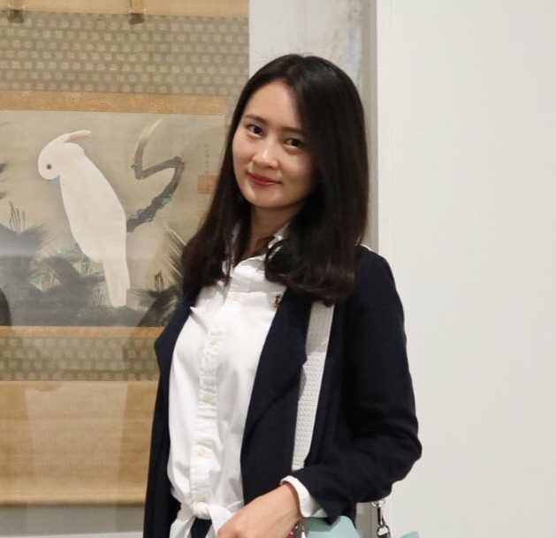
TEAM MEMBERS
SOUMIYA ROY
NUID: 001220681
BHARAT PARWANI
NUID: 001222816
YUANYUAN ZHOU
NUID: 001233834
JIAMIN WANG
NUID: 001289959

Slide 3
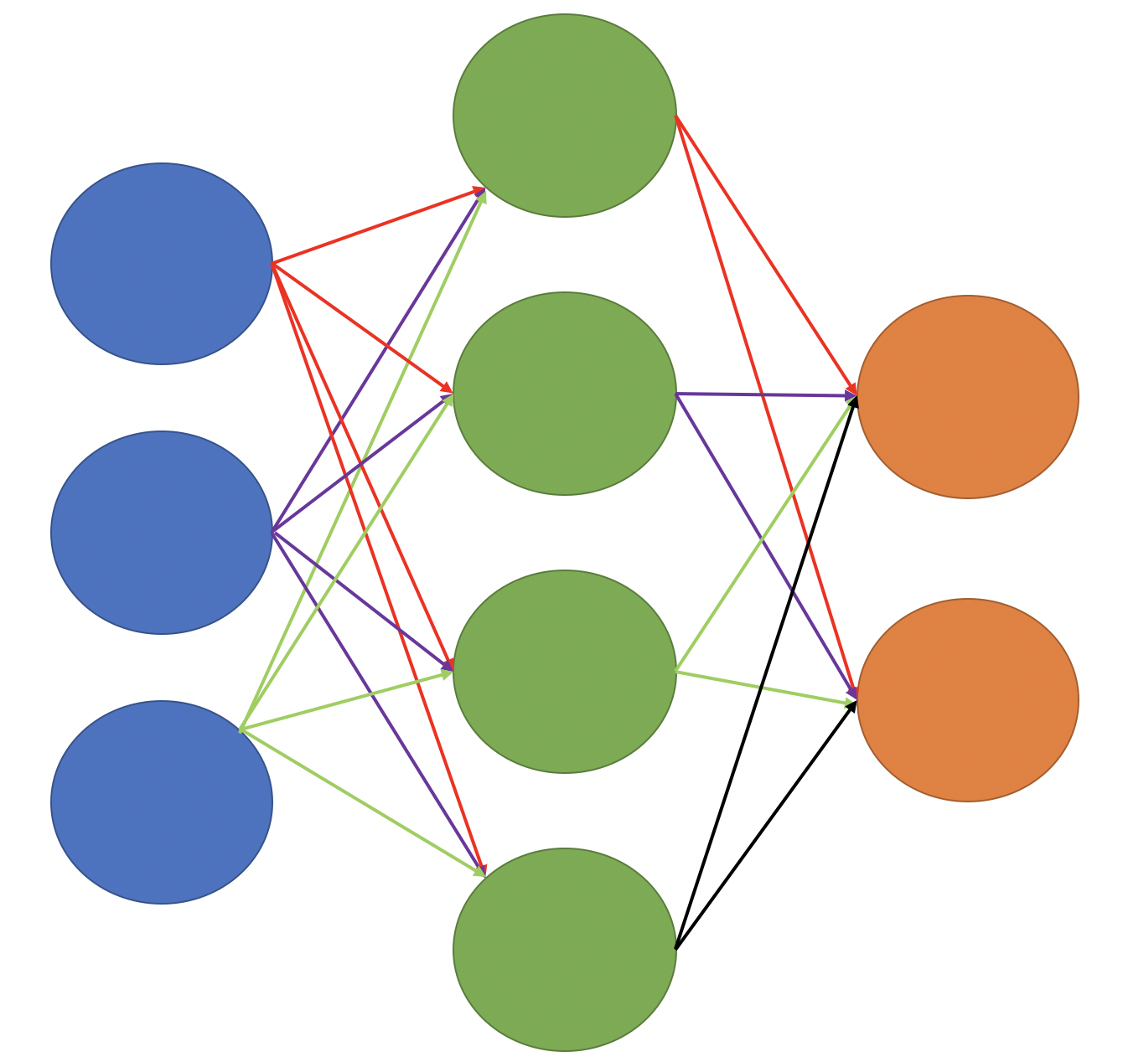
Neural Network: Prudential Insurance

Slide 4
What is Neural Networks?
Neural networks are a set of algorithms, modeled loosely after the human brain, that are designed to recognize patterns
Interpret sensory data through a kind of machine perception, labeling or clustering raw input
Patterns they recognize are numerical, contained in vectors, into which all real-world data, be it images, sound, text or time series, must be translated
Deep neural networks is distinguished from the more commonplace single-hidden-layer neural networks by their depth- the number of node layers through which data passes in a multistep process of pattern recognition

Slide 5
Neural Network with Prudential Dataset

Slide 6
Data preprocessing
Similar to the mid-term project:
Remove noise
Add the missing values
Reduce dimension
Data transformation
Split train and test dataset
Improvements:
Lowering the p-value to select the more precise attributes
Eventually selected 24 columns to fit into the model.

Slide 7
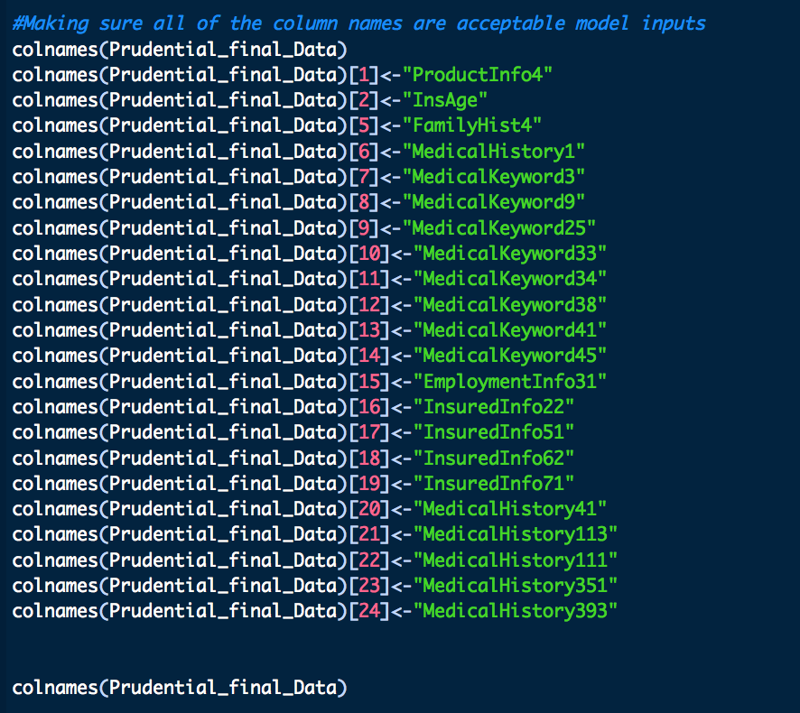
Selected Columns:

Slide 8
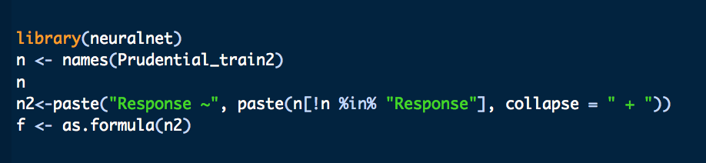
STEP 1: Running Neural Networks
Establish the formula to put in the model

Slide 9
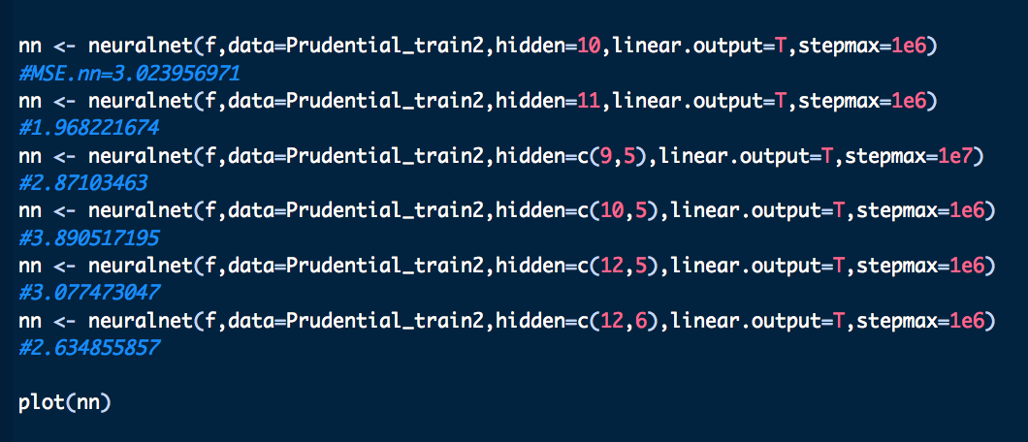
STEP 2: Building models
Building models with different hidden layers and nodes.

Slide 10

STEP 3: Predicting the Model

Slide 11
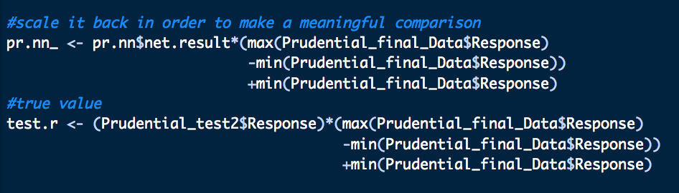
STEP 4: Scaling the Response
Scale the ‘Response’ back in order to make a meaningful comparison

Slide 12
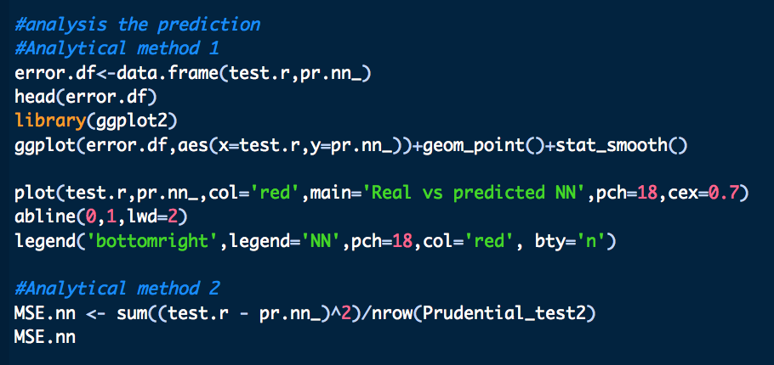
STEP 5: Prediction Analysis

Slide 13
MSE: 1.96
Model 2 with 11 hidden layers

Slide 14
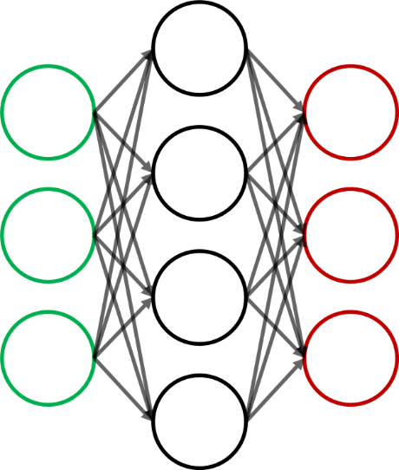
Convolutional Neural Network: Semeion Handwritten Digit Dataset

Slide 15
What is Convolutional Neural Network?
A Convnet is a special kind of neural networks which contains at least one convolutional layer. A typical convnet structure takes an image, passes it through a series of convolutional layers, nonlinear activation layers, pooling (downsampling) and a fully connected layer to output the classification labels.

Slide 16
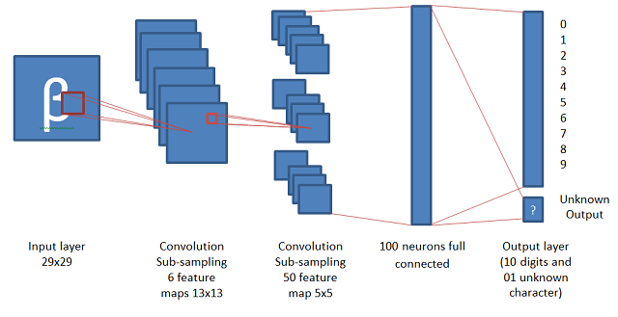
Convolutional Neural Network

Slide 17
Example:
Image: 5x5 matrix of values with a 3x3 matrix (kernel) and slide that 3x3 window around the image (distance that matrix moves is called stride). At each position the 3x3 visits, the matrix multiplies the values of the 3x3 window by the values in the image that are currently being covered by the window. This results in a single number the represents all the values in that window of the image. The goal of a convolutional layer is filtering. As we move over an image we check for patterns in that section of the image. This works because of filters, stacks of weights represented as a vector, which are multiplied by the values generated by the convolution.When training an image, these weights change, and so when it is time to evaluate an image, these weights return high values if it thinks it is seeing a pattern it has seen before. The combinations of high weights from various filters let the network predict the content of an image.
Notes:
Images are sometimes padded with zeros around the perimeter when performing convolutions, which dampens the value of the convolutions around the edges of the image (center of photos matter more).

Slide 18
CNN vs NN
Regular neural network:
Uses the entire image to train the network
Works well for simple centered image (for example a centered handwritten digit image) but fails to recognize image with more complex variation (for example a running cat in backyard)
Having more hidden layers to learn abstract features would help but impractical as we need far too many neurons to train and store in memory.
Convolutional Neural network:
Recognizes an object by first looking for low level features such as edges, lines and curves, and then building up more abstract features through series of convolutional layers.
Network learns individual parts of an object by shared filters on small regions of the image, and add them up to build abstract features. The use of shared filters largely reduce the actual parameter learning.
Generalizes better for complex image recognition as learned filters can be reused to detect abstract features compositionally through convolutional layers.

Slide 19
Convolutional Neural Networks with Semeion Dataset

Slide 20
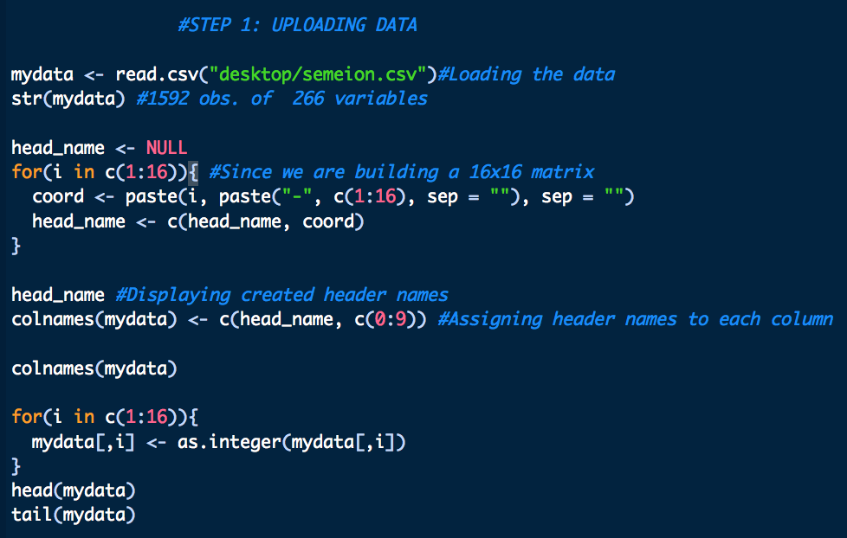
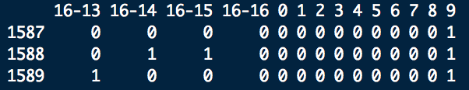
STEP 1: Uploading the Semeion dataset
Total: 266 columns
Last 10: Used to predict the numbers

Slide 21
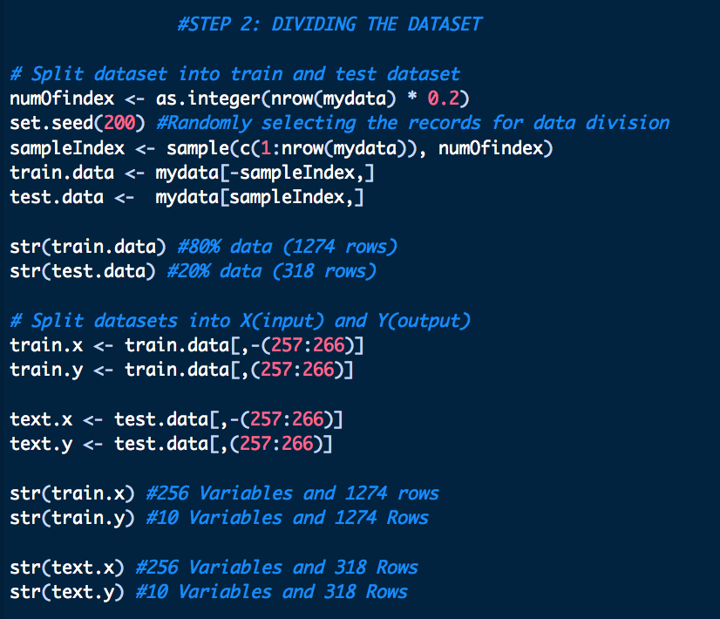
STEP 2: Dividing the dataset into Train and Test

Slide 22
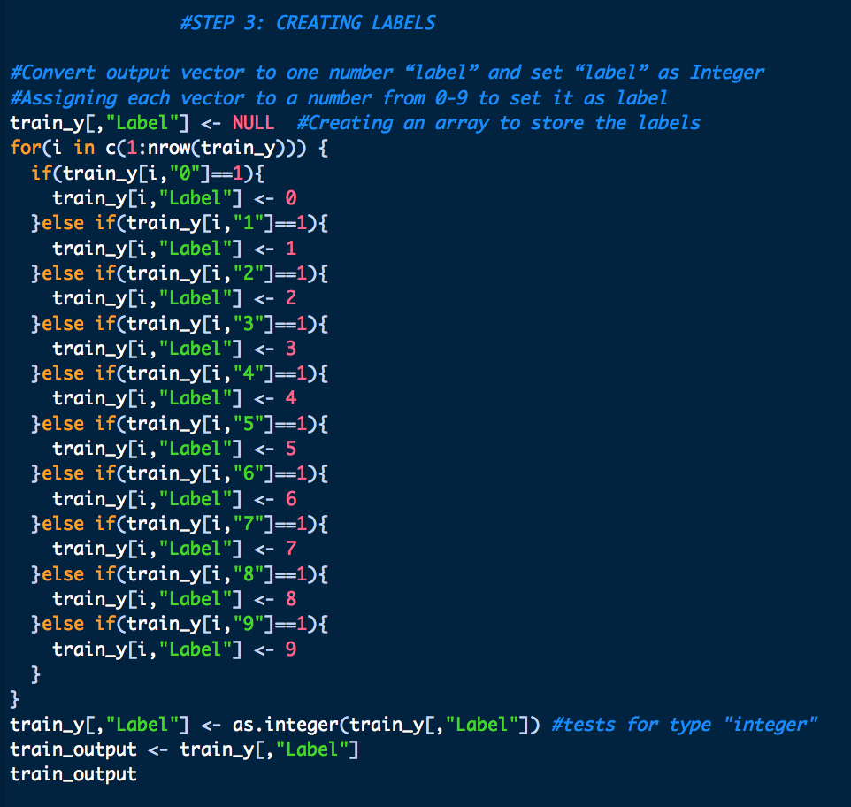
STEP 3: Creating Labels

Slide 23
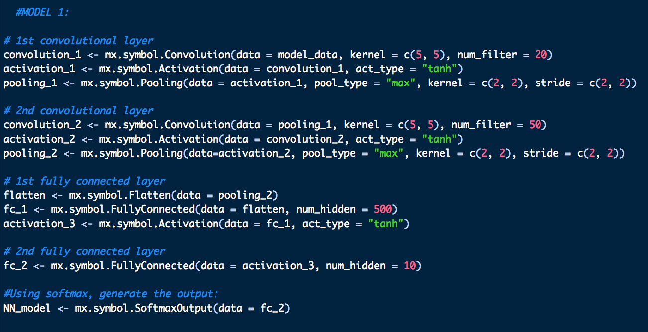
STEP 4: Building the three models- Model 1
Convolutional Layer #1: Applies 20 5x5 filters (extracting 5x5-pixel subregions), with tanh activation function
Pooling Layer #1: Performs max pooling with a 2x2 filter and stride of 2 (which specifies that pooled regions do not overlap)
Convolutional Layer #2: Applies 50 5x5 filters, with tanh activation function
Pooling Layer #2: Again, performs max pooling with a 2x2 filter and stride of 2

Slide 24
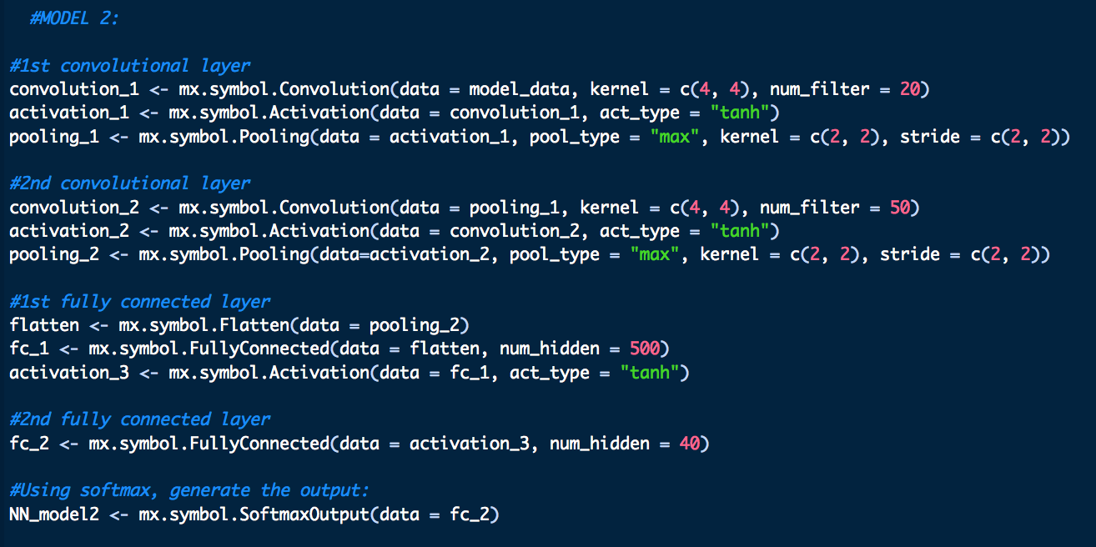
STEP 4: Building the three models- Model 2
Convolutional Layer #1: Applies 20 4x4 filters (extracting 4x4-pixel subregions), with tanh activation function
Pooling Layer #1: Performs max pooling with a 2x2 filter and stride of 2 (which specifies that pooled regions do not overlap)
Convolutional Layer #2: Applies 50 4x4 filters, with tanh activation function
Pooling Layer #2: Again, performs max pooling with a 2x2 filter and stride of 2

Slide 25
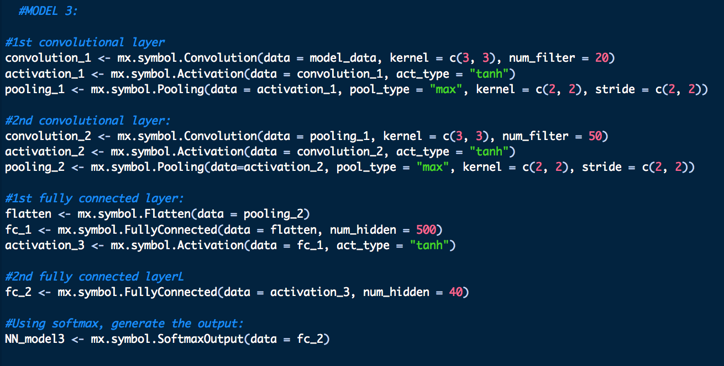
STEP 4: Building the three models- Model 3
Convolutional Layer #1: Applies 20 3x3 filters (extracting 3x3-pixel subregions), with tanh activation function
Pooling Layer #1: Performs max pooling with a 2x2 filter and stride of 2 (which specifies that pooled regions do not overlap)
Convolutional Layer #2: Applies 50 3x3 filters, with tanh activation function
Pooling Layer #2: Again, performs max pooling with a 2x2 filter and stride of 2

Slide 26
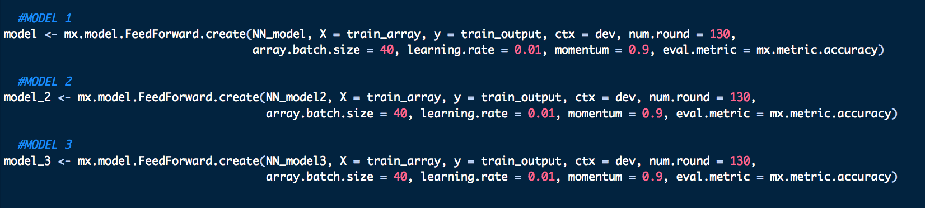
STEP 5: Training the Model
HYPERPARAMETERS:
Learning Rate: controls how much to update the weight in the optimization algorithm
Batch Size: defines number of samples that going to be propagated through the network
Activation Function: defines the output of that node given an input or set of inputs
Number of hidden layers/units
Num.round: Number of times the data is trained for accuracy

Slide 27
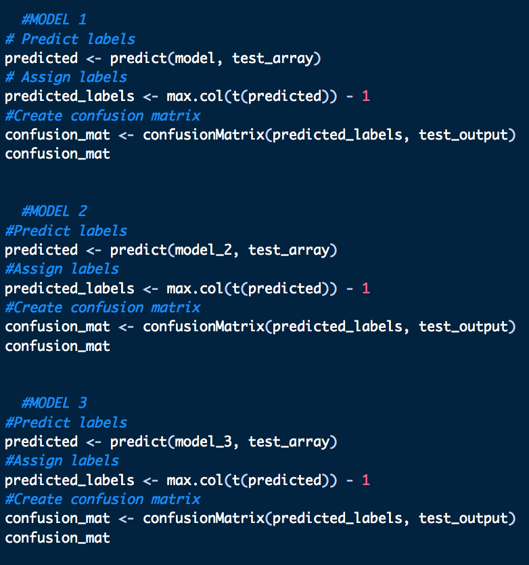
STEP 6: Testing the models

Slide 28
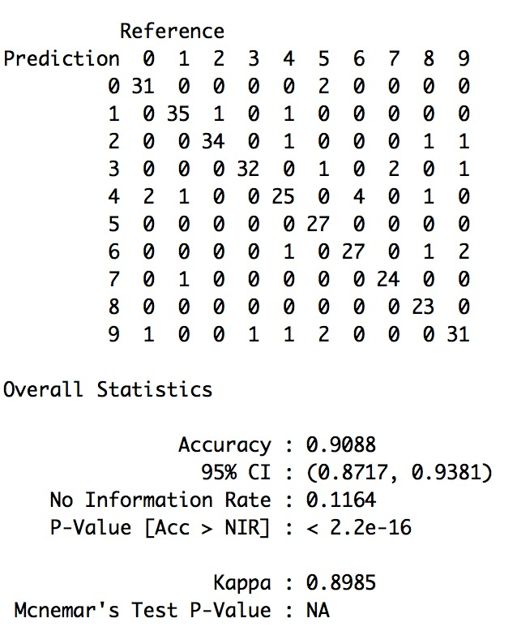
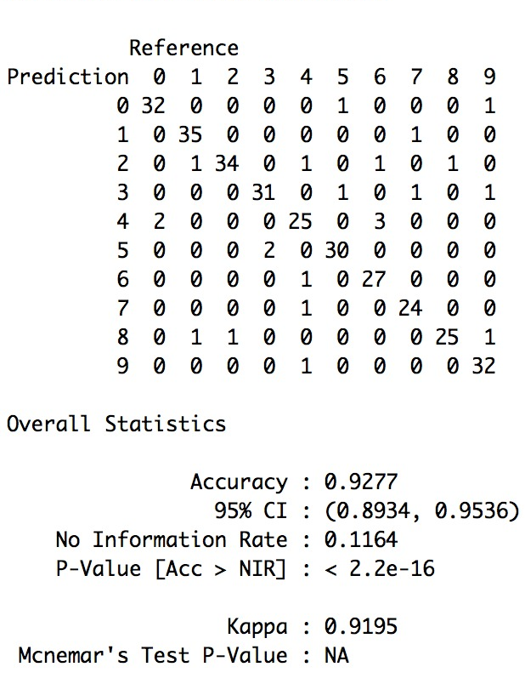
RESULT: Accuracy
MODEL 1
MODEL 2
MODEL 3

Slide 29
95.91%
Model 1 with 5x5 filters and tanh activation function

Slide 30
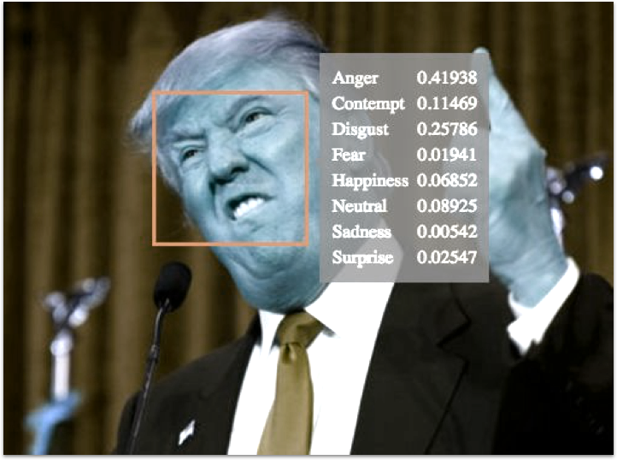
Recommendation/Future work
Gather handwritten samples from different demographics and age groups to analyze the pattern
Based on the mass handwritten samples, find out the emotional sentiments of the individual at the time of sample gathering
Apply facial recognition and image processing techniques on politicians and participants to decide the outcome based on artificial intelligence

Slide 31
Thank You

